Slide 1
The ODD couple: Clinical Risk Management via ISO14155 and ISO14971
Joy Frestedt, PhD, RAC, CPI, FRAPS, FACRP
April 24, 2025 8:40am - 9:40am
18th Annual Device Research & Regulatory Conference
Society of Clinical Research Associates (SOCRA)
Apr 24 - 25, 2025 at Hyatt Regency Newport Beach, Newport Beach, California

Slide 2
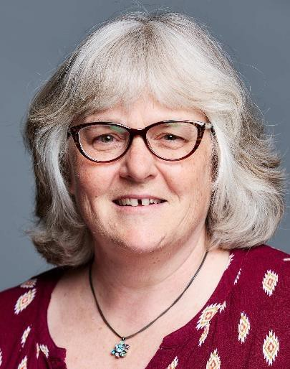
About your presenter:
Joy Frestedt, PhD, RAC, CPI, FRAPS, FACRP
Dr. Frestedt is President and CEO of Frestedt Incorporated (www.frestedt.com), Alimentix and the Frestedt Learning Center. She has served 45 years in clinical research, regulatory affairs, quality system development and business leadership in pharmaceutical, medical device and food companies. She has experience designing, running and monitoring clinical trials, negotiating regulatory decisions, developing quality systems, designing and conducting laboratory analyses, overseeing biomedical engineering activities and assisting firms with strategic decisions to compete globally
Dr. Frestedt was VP Clinical/Scientific Affairs, Kerecis, Bridgepoint Medical, Humanetics; Chief Scientific Officer, Eva Medtec; Interim Regulatory Director, University of Minnesota Academic Health Center; Allina IRB member, Manager Clinical Affairs, Ortho Biotech; CRO Liaison, Medtronic; Operations Manager, Mayo Clinical Trial Services Unit; Medical Information Scientist, AstraZeneca; Manager Clinical Development, Orphan Medical.
She holds a BA from Knox College and a PhD in Pathobiology from the University of Minnesota Medical School. She authored 1000s of presentations, 100s of articles and three books: “Planning, Writing and Reviewing Medical Device Clinical and Performance Evaluation Reports (CERs/PERs) A Practical Guide for the European Union and Other Countries” with Elsevier, “Warning Letters: 2016 Reference Guide” with Barnett International and “FDA Warning Letters About Food Products: How to Avoid or Respond to Citations” with Elsevier.
Joy Frestedt, PhD
jf@frestedt.com
612-219-9982
Frestedt Incorporated
2021-2025 Best of Minneapolis (Minneapolis Awards Program),
2019 Company of the Year (Pharma Tech Outlook)
2016 Best for Biotechnology Clinical Research – Minnesota (GHP Magazine)
RAC (Regulatory Affairs Certified) Premier credential for regulatory professionals in healthcare
CPI (Certified Principal Investigator) Validated expertise in conducting clinical trials
FRAPS (Fellow of Regulatory Affairs Professionals Society) Recognized leadership in regulatory affairs
FACRP (Fellow of Association of Clinical Research Professionals) Advanced professional standing in clinical research

Slide 3
Course Description
The integration of device engineering risk concepts into clinical trial risk management activities is advancing at a fast clip. In addition, the identification of pre-defined and pre-quantified safety and performance acceptance criteria has become a required step in clinical evaluations. Putting these concepts together in the work required for clinical trials is new territory for us to explore together.

Slide 4
Key Messages
ISO14155 and ISO14971 are not aligned
Risk is approached from different perspectives
Clinical trials need “standardized” risk management
Risk management has clinical inputs and outputs
Risk Management File must integrate clinical benefit and risk data in REAL time
LET’S COMMUNICATE BETTER!

Slide 5
Agenda
Who is the audience for this course?
What are ISO14155 and ISO14971?
When, where and how do we communicate RISK?
  Clinician ↔ Engineer
  Understanding clinical and engineering language
Why are ISO14155 and ISO14971 an “Odd Couple”?
Case Study and Group Activity
Wrap up!!!

Slide 6
Disclaimers
Dr. Frestedt has no conflicts of interest to report; however, she pays fees to serve on ISO standards committees through ANSI/AAMI for the US.
NOTE: ISO STANDARDS REQUIRE PURCHASE
ISO 14155:2020 - Clinical investigation of medical devices for human subjects — Good clinical practice
ISO 14971:2019 - Medical devices — Application of risk management to medical devices
This talk is intended for educational purposes only as required for implementation and does NOT replace required purchases of these COPYRIGHTED standards prior to implementation.

Slide 7
Who is this course designed to help?
Clinicians and Engineers
How do we discuss RISK together?
how early
how often
how well
Through layers and layers of complexity…
what works best?

Slide 8
Our purpose may differ...
CLINICIANS
ENGINEERS
ISO14155
Clinical Risks
Documenting human benefits and mitigating risks during controlled clinical trials to test device safety and performance
To ensure devices are safe, effective and meet regulatory requirements.
Risk mitigation informs clinical trial protocols and clinical data validates risk control
ISO14971
Engineering Risks
Documenting device hazards and mitigating risks during controlled device designs to benefit patients and users

Slide 9
What are ISO14155 and ISO14971?
List some similarities
Define what standards “mean” about “risk”
Can we align clinical and engineering “risks”?
Explain how standards are related
Describe compliance overlaps

Slide 10
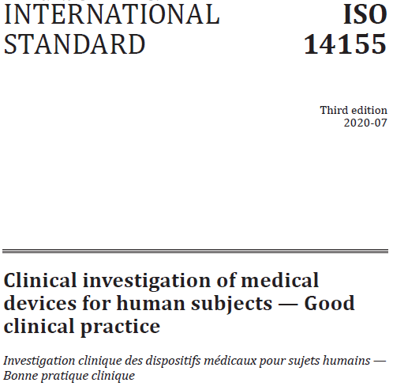
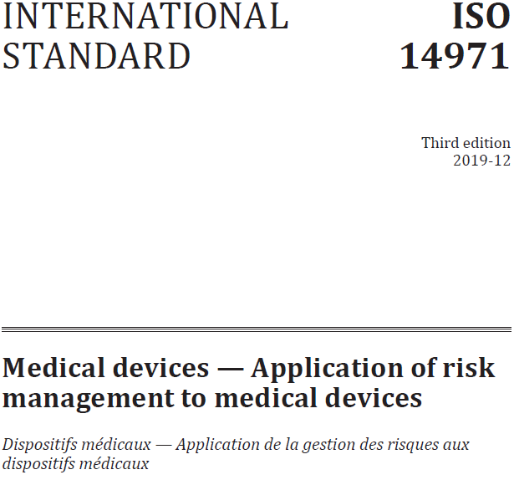
Note Similar Word: “Risk”
Risk: 119 times!
Risk: 587 times!
These may not be about the identical topic!
BUT they are to be used TOGETHER!

Slide 11
What Does “Risk” Mean?
ISO14155 Scope: To address “good clinical practice for the design, conduct, recording and reporting of clinical investigations carried out in human subjects to assess the clinical performance or effectiveness and safety of medical devices.”
ISO14971 Scope: “The process… intends to assist manufacturers of medical devices to identify the hazards associated with the medical device, to estimate and evaluate the associated risks, to control these risks, and to monitor the effectiveness of the controls.”
RISK?

Slide 12
Are Purposes “Different” ?
ISO14155
ISO14971
  Systematically employ Good Clinical Practice (GCP) in medical device clinical investigations (e.g., to protect human subject rights/safety) across clinical trial experience (baseline, treatment, follow-up)
  Ensures regulatory/ethical compliance (e.g., Declaration of Helsinki)
  Ensures patient safety
  Ensures credible clinical data (scientific validity)
Systematically identify, analyze and mitigate (reduce) medical device risks (e.g., to improve device design, reduce flaws, misuse) across device lifecycle (design, production, pre-market and post-market).
Ensures regulatory compliance
Ensures hazards, risk controls, and residual risks are documented
Ensures risks are mitigated to an “acceptable” level

Slide 13
Can we Align “Risks”?
ISO14155
ISO14971
Focus: to collect human clinical data about device safety and performance (including risks)
Starts with protocol writing
  after “clinical” device is developed and “non-clinically” tested
  typically after potential clinical risks identified
Requires: risk management principles applied before (protocol), during (data collection) and after (analyzing/reporting) clinical trial to EVALUATE safety and performance.
Focus: to identify, estimate, evaluate, control and monitor risks associated with the device
Starts with hazard identification
  before “prototype” is developed for “non-clinical” testing
  typically before any human clinical use
Requires: risk management principles applied throughout device lifecycle (before and after device production to CONTROL risks).

Slide 14
Functions Are Related
ISO14971 is a normative reference within ISO14155 to ensure medical device risk management (RM) is embedded in clinical investigations, bridging engineering and clinical safety requirements (ISO14971 has no normative references).
A normative reference is a document providing mandatory standards, guidelines, or specifications to be followed in a particular context.
This is why we’re talking about these two standards together because this means clinical trials need to be done within risk management framework

Slide 15
Knowledge Check #1
Which statement best describes the primary purposes of ISO14155 and ISO14971?
ISO14155 ensures device efficacy, while ISO14971 focuses solely on manufacturing quality control.
Both standards primarily address post-market surveillance requirements for medical devices.
ISO14155 replaces ISO14971 during clinical investigations of high-risk devices.
ISO14155 protects trial subjects and ensures reliable clinical data, while ISO14971 manages risks throughout the device lifecycle.

Slide 16
Knowledge Check #1
Which statement best describes the primary purposes of ISO14155 and ISO14971?
ISO14155 ensures device efficacy, while ISO14971 focuses solely on manufacturing quality control.
Both standards primarily address post-market surveillance requirements for medical devices.
ISO14155 replaces ISO14971 during clinical investigations of high-risk devices.
ISO14155 protects trial subjects and ensures reliable clinical data, while ISO14971 manages risks throughout the device lifecycle.

Slide 17
RM Teams Work Hard!
ISO14155 RM Process
ISO14971 RM Process
Plan
Protocol must identify and consider all clinical trial risks
Monitor
Sponsor must continuously observe, evaluate and react to risks throughout the trial
Report
Analyze/report findings, including risk mitigations
Risk Assessment (analysis and evaluation)
Risk Control
Evaluation of Overall Residual Risk
Risk Manage-ment Review
Production and Post-Production Activities

Slide 18
Problem Statement
“Risk management is a complex subject because each stakeholder can place a different value on the acceptability of risks in relation to the anticipated benefits.” (ISO14971 Intro)
Challenge
  Engineers prioritize device-related risks (e.g., mechanical failure), while clinicians focus on patient outcomes (e.g., adverse effects).
  Communication gap can lead to misunderstandings, slower progress and tools missing the mark for current, real-world healthcare needs.
Goal
  Bridging perspectives and clarifying “risk” language should ensure more comprehensive risk management alignment.

Slide 19
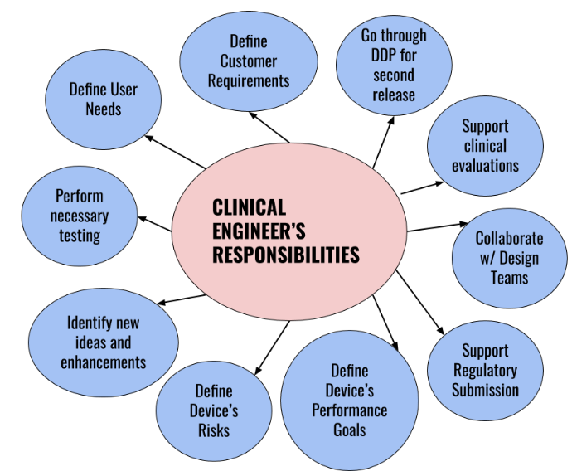
DDP: design and development phase
Bench and animal testing
Validate and verify device designs
Traceable benefits AND risks
From (40) How to Understand the Importance of Clinical Engineering | LinkedIn

Slide 20
Knowledge Check #2
Which activities do engineers perform in ISO14971 risk management?
Risk identification from all applicable sources (design, materials, use errors)
Risk assessment (severity/probability evaluation)
Risk control implementation (design changes, protective measures)
Benefit-risk analysis & report
All of the above

Slide 21
Knowledge Check #2
Which of the following activities do engineers perform in ISO14971 risk management?
Risk identification from all applicable sources (design, materials, use errors)
Risk assessment (severity/probability evaluation)
Risk control implementation (design changes, protective measures)
Benefit-risk analysis & report
All of the above

Slide 22
When, where and how do we communicate RISK?
  Clinician ↔ Engineer
  Understanding clinical and engineering language

Slide 23
When is Risk Communicated?
ISO14971 Throughout device lifetime (from ideation, risk management planning, development, production and post-production marketing to end of life and obsolescence)
ISO14155 Throughout clinical development stages (from clinical trial planning, protocol writing and clinical trial conduct to reporting and use in next stage)
Trial types
Pilot→Pivotal→Post Market

Slide 24
Risk Management is Continuous
Risk Management Plan
Risk Management Documents
Risk Management Report
Clinical Trial Protocol
Clinical Trial Records
Clinical Trial Report
“The clinical investigation should be designed to allow confirmation of the benefit-risk analysis of the investigational device as outlined in the risk management report.” (ISO14155, Section 6.3)
ISO14971
Medical Device
Risk Management
ISO14155
Clinical Trial
Good Clinical Practice

Slide 25
Where is Risk Communicated?
ISO14155
Clinical Trial Documents
ISO14971
Risk Management File
Clinical Trial Protocol
  Device/procedure risk acceptability thresholds, benefit-risk analysis, literature review
  Benefits must justify risks
  Information to subjects (risk description, alternatives)
  Investigators Brochure (IB)
  Instructions for Use (IFU)
  Residual risks, changes
Clinical Trial Records
  Risk assessment, management, risk-based monitoring, control, stopping rules
Clinical Trial Report
  Risk evaluation: does report confirm benefit-risk analysis in Risk Management Report
Risk Management Plan
  Risk acceptability criteria and determinations
  Document all plan changes
Risk Management Documents
  Failure Modes and Effects Analyses (FMEA)
  Risk estimation (harm severity x occurrence)
  Risk analyses, control measures, new risks, verifications, benefit-risk analyses
  Intended use/foreseeable misuse
  Safety characteristics and limits
  Hazards and hazardous situations
  Traceability: each hazard to risk analysis, evaluation, control and residual risks
  Residual risks (per risk acceptability)
Risk Management Report
  Does risk evaluation align with clinical data in Clinical Trial Report?

Slide 26
Communication Questions
How are acceptable risks determined?
What are good evaluation methods?
  Benefits and risks
  Safety and performance
  NEEDS
  Specialized training
  Competent personnel
  Ability to adapt to evolving data
  Attention to detail and “completeness”

Slide 27
Knowledge Check #3
According to ISO14971, which activities are not part of the risk management process for medical devices?
Performing marketing surveys to assess competitor pricing
Identifying hazards and hazardous situations from design, materials, and foreseeable misuse
Conducting benefit-risk analysis to compare residual risks with clinical benefits
Implementing risk controls (e.g., design modifications, alarms)

Slide 28
Knowledge Check #3
According to ISO14971, which activities are not part of the risk management process for medical devices?
Performing marketing surveys to assess competitor pricing
Identifying hazards and hazardous situations from design, materials, and foreseeable misuse
Conducting benefit-risk analysis to compare residual risks with clinical benefits
Implementing risk controls (e.g., design modifications, alarms)

Slide 29
Where Does Risk Work Overlap?
Risk begins with clinical trial protocol development after device was developed
Risk Management begins with device idea; trial is in the middle of RM process
Clinical Trial Risk Management - ISO14155
Before trial, device and procedure risks must be estimated (per ISO14971) in an objective review of medical/scientific data.
A benefit-risk analysis summary of “residual risk… nature (hazards), incidence (occurrence), severity and outcome (harms)” must be disclosed in Investigator’s Brochure, Instructions for Use.
Protocol and informed consent form must disclose adverse device effects and benefit-risk ratio rationale.
Training must be offered when required and trial must be registered.
Device Risk Management - ISO14971
Starts with an idea for a device
Throughout device life “systematic… tasks of analyzing, evaluating, controlling and monitoring risk” must be ongoing.
Must include “identifying hazards and hazardous situations associated with a medical device… estimating and evaluating the associated risks… controlling these risks, and monitoring the effectiveness of the risk control measures.”
Any changes to Benefit-Risk Analysis or overall residual risk (still acceptable?)

Slide 30
Does Overlap Change With Time?
Risks are learned during clinical trial
Benefit-Risk Profile needs to be updated in the RM File
Trial Risk Management - ISO14155
Residual risks (risk analysis and trial subject risks) must be balanced by subject benefits.
Systematic risk identification and mitigation must be ongoing during medical device investigations.
Predefined risk acceptability thresholds (e.g., failure rates, accuracy) trigger risk assessments / more risk controls as needed!
Device Risk Management – ISO14971
Includes risk analysis, evaluation, control, “production and post-production activities”
Manages potential hazards from design, materials, or manufacturing flaws that could compromise device safety or functionality
After clinical trial/s, before marketing, manufacturer must review and report if risk management file is appropriate / acceptable

Slide 31
Does Risk Overlap End?
Clinical trial reports must document benefits and risks
RM reports must be updated throughout device lifetime
Clinical Trial Risk Management - ISO14155
Close out (Section 8) trial when completed, futile or unacceptable risk was not controlled/mitigated (may require expedited regulatory reporting)
Clinical Investigation Report (Section 8.4) is a “critical appraisal of the results compared to the objectives of the clinical investigation” and must be entered in publicly available database
    Risk Assessment and Conclusions (Section 8.5) is a “formal review of risk information should be… fed into the risk analysis and clinical evaluation with an update of the benefit-risk conclusions”
    Risks must be traceable form clinical trial to RM file and all labeling updated with new benefits and risks estimates
Device Risk Management - ISO14971
Risk management is ongoing until device is obsoleted as a “systematic… tasks of analyzing, evaluating, controlling and monitoring risk”
must include “identifying hazards and hazardous situations associated with a medical device… estimating and evaluating the associated risks… controlling these risks, and monitoring the effectiveness of the risk control measures.”
Including risk analysis, evaluation, control as well as “production and post-production activities”
Also manages potential hazards arising from design, materials, or manufacturing flaws that could compromise device safety or functionality

Slide 32
How to Communicate Risk?
ISO14155
ISO14971
Document risk control measures
  Quality Management System (“standard operating procedures, computerized systems, personnel”)
  Trial Planning and Conduct (trial design, data collection, informed consent, monitoring, auditing)
  Reporting (report risks to investigators in real time and formally review risk information and update benefit-risk profile in final study report)
Collect and review information
  Production/process
  User
  Supply chain
  Publicly available data
  State of the art changes
Act on new safety information
  Need to modify device
  Consider recall
  Escalate to top management (is risk management “suitable”?)

Slide 33
Trial with ?Unacceptable Risks?
Risk identified and PI and Sponsor informed
Risk compared to established risk acceptability thresholds
Preliminary risk analysis finds
a) Risk was within risk expectations
OR
b) Trial suspended for comprehensive risk assessment per ISO14971
When required, comprehensive risk analysis finds
a) Risk was within risk expectations OR
b) Corrective actions with revised benefit-risk analysis allows valid trial to continue (if validity in question, trial terminated) OR
c) If corrective actions are not possible, trial terminated

Slide 34
Knowledge Check #4
What shared responsibility do engineering and clinical teams have under ISO14155 and ISO14971?
Only engineers ensure patient safety through design controls.
Both teams perform risk-benefit analyses to align device design with clinical safety outcomes.
Clinical teams solely validate device performance without reviewing engineering risk data.
Post-market monitoring is delegated to regulatory authorities.

Slide 35
Knowledge Check #4
What shared responsibility do engineering and clinical teams have under ISO 14155 and ISO 14971?
Only engineers ensure patient safety through design controls.
Both teams perform risk-benefit analyses to align device design with clinical safety outcomes.
Clinical teams solely validate device performance without reviewing engineering risk data.
Post-market monitoring is delegated to regulatory authorities.

Slide 36
Why are ISO14155 and ISO14971 an “Odd Couple”?
Different languages
Different timeframes
Different perspectives
Different processes

Slide 37
Why is the Coupling Odd?
ISO14155 and ISO14971 use different “language”
  Engineering risk: technology features and device functions
  Clinical risk: patient symptoms and treatment effects
ISO14971 is operational throughout the device lifecycle, while ISO14155 is only during clinical trials.
Bridging engineering and clinical perspectives can be challenging due to differing terminologies, methodologies and goals.

Slide 38
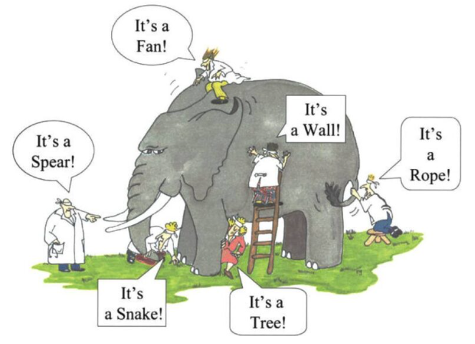
How Do You See Risk?
Different perspectives can lead to “odd” challenges
Perception vs Perspective - What is the difference?

Slide 39
Case Study and Group Activity

Slide 40
Case Study Introduction
Patients with lung diseases (e.g., bronchiectasis, asthma and chronic obstructive pulmonary disease, cystic fibrosis)
High frequency chest wall oscillation (HFWCO) devices squeeze and release the chest wall to facilitate mucous clearance (e.g., HFCWO vest devices deliver rapid, repeating pulses of positive air pressure)

Slide 41
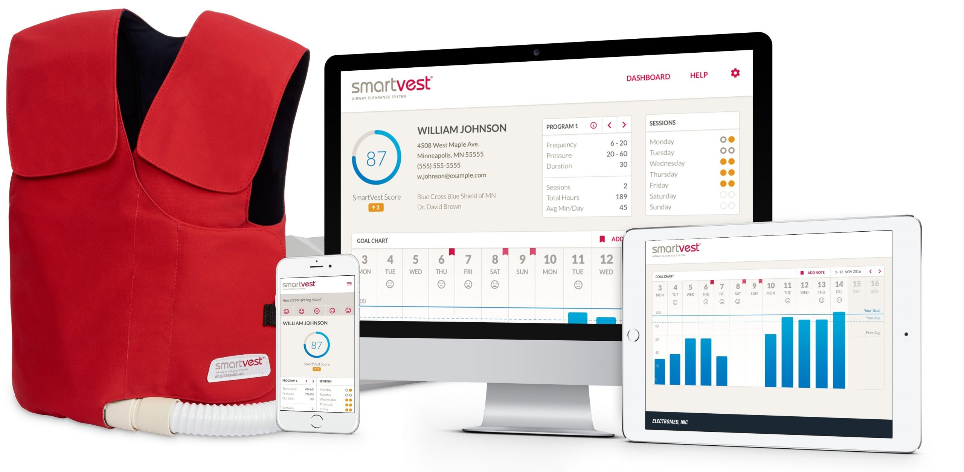
Group Activity
How might an engineer evaluate risk in this case study of patients with lung disease treated by using a vest delivering high frequency chest wall oscillations (HFCWO)?
vest
Identify risks
Evaluate risks
Control risks
Report risk management file
vest
vest

Slide 42
Failure Modes and Effects Analysis
One engineering method is a FMEA which evaluates a hazardous situation, also called a device failure mode, potentially leading to a harm to a patient, user or the environment as part of the overall risk analysis:
Risk Identification: List failure modes (e.g., insufficient air pulses to compress chest, incorrect programming) and their potential hazards (therapy not delivered properly or delayed while vest fit or device program is fixed)
Risk Analysis & Evaluation: Assign severity (1–10) and probability (1–10) scores to each failure mode; calculate Risk Priority Numbers (RPNs as severity x probability) to prioritize risks (by the numbers)
Risk Control: Identify and implement mitigations (e.g., redundant sensors to alarm if air pulses are not delivered as prescribed, user training about device use, alarm optimization) to reduce RPNs below acceptable thresholds
Benefit-Risk Analysis & Reporting: Compare residual risks (e.g., rare software glitches) to clinical benefits (e.g., precise therapy delivery) and document in a Risk Management Report

Slide 43
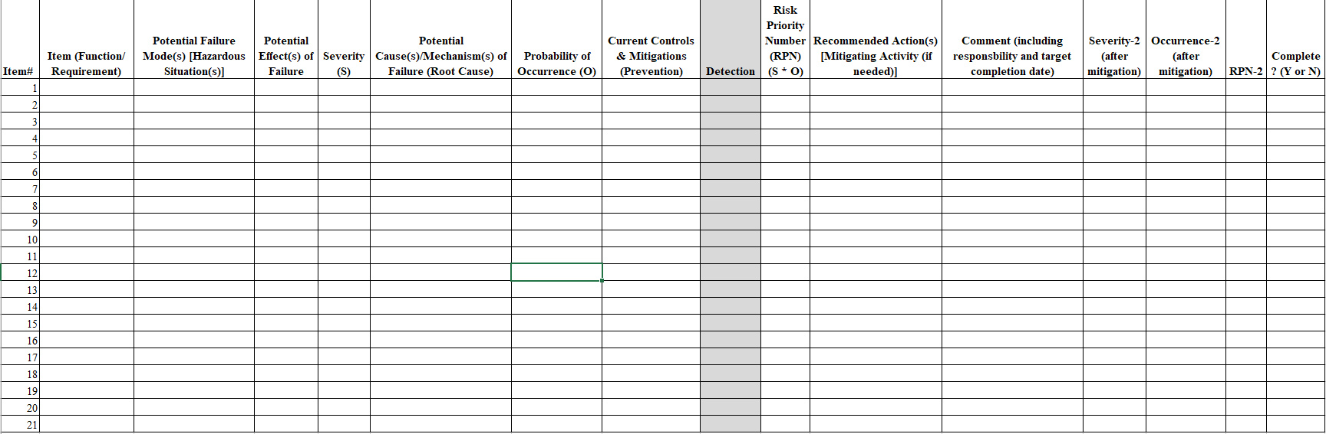
Failure Modes and Effects Analysis
Four Types of FMEAs:
Design, process, use, software
Engineers identify data to put in each column (one item at a time)

Slide 44
EXAMPLE: dFMEA (design)
Device stops working
NOTE: how “scales” need careful definition
Therapy not delivered
Severity: Medium (3 on a 5-point scale)
Cause: Battery failure
Occurrence: Medium (3 on a 5-point scale)
Current controls: None
Easy to detect (scale not used, see occurrence)
Risk Priority Number (3x3) = 9
Redesign to use rechargeable batteries, add alarms for low battery and instructions for recharging/replacement
All actions completed
Severity 3 (same), Occurrence 1 and RPN=3 (lowered)

Slide 45
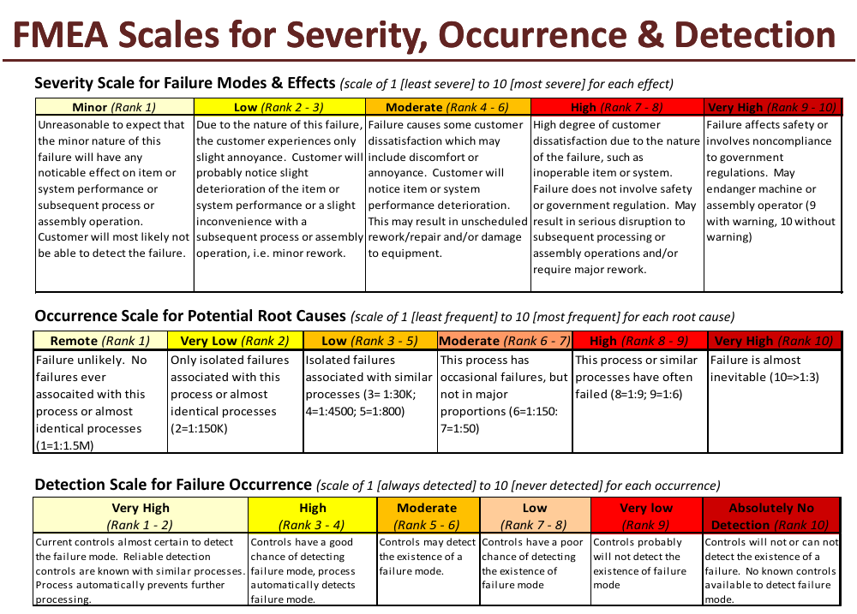
EXAMPLE: Scales
https://statstuff.com/ssfiles/tools/FMEAScalesGuide.pdf

Slide 46
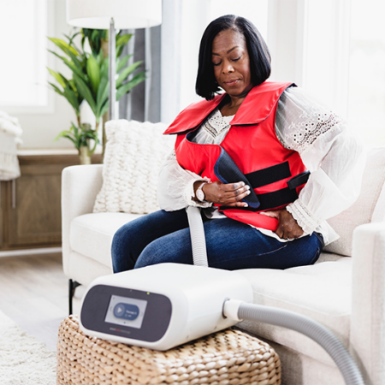
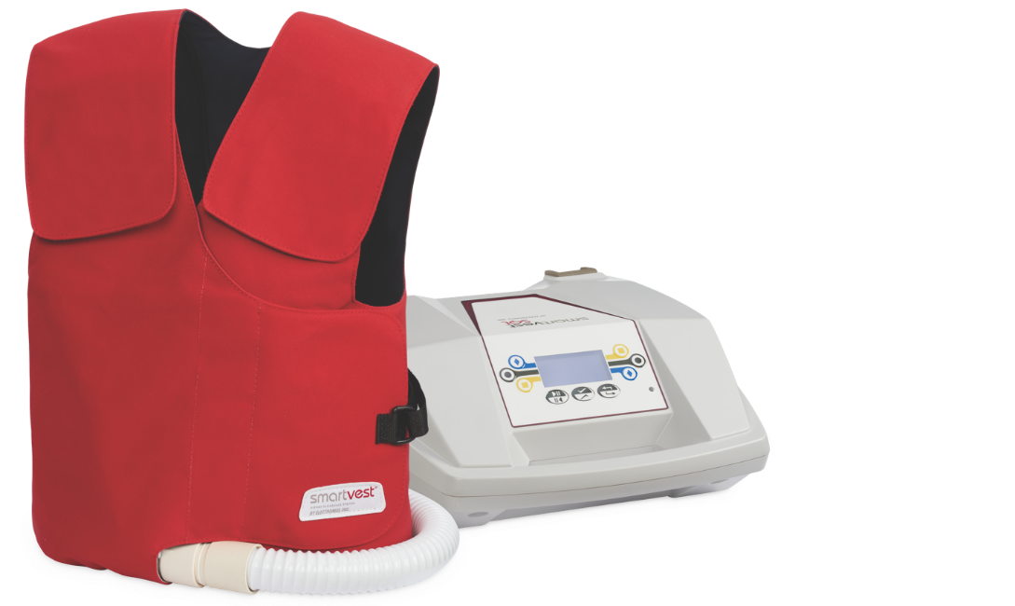
Lung Therapy Example
HFCWO: High frequency chest wall oscillation
Clinician’s Risk Perspective:
Rib fracture risk is high in patient with osteoporosis; use precise pressure settings.
Engineer’s Risk Perspective:
Poor strap adjustability may result in poor fit; design size options to span all body sizes.
2022_SMARTVESTSW_2808-sm-450x450.png (450×450)
smartvest-and-generator-hero.png (1440×860)

Slide 47
Wrap up!!!

Slide 48
When We Communicate Most
Writing Clinical Trial Protocol at Trial Start
All clinical benefits and risks identified in Risk Management File must be fully considered in Protocol
Align on technical and clinical objectives to ensure protocol addresses device functionality and patient safety
Writing Clinical Trial Report at Trial End
Document in clinical trial report if trial confirmed benefit-risk analysis outlined in risk management report
All clinical benefits and risks learned in each clinical trial must be updated in Risk Management File

Slide 49
Where We Work Together
Risk Management Meetings: Discussing hazard identification, severity, probability, risk controls, residual risks, etc.
Clinical Trial Planning Sessions: Linking investigational device benefit-risk analysis from the risk management report into clinical trial protocol
Clinical Trial Analysis and Report Sessions: Input new benefits, risks and changes to benefit-risk profile from clinical trial into risk management process

Slide 50
Why We Work Together
Miscommunication during protocol writing can lead to incomplete risk assessments or trial designs failing to capture critical data.
Miscommunication during report writing can lead to incomplete risk assessments or risk management files failing to appropriately control risks.
Ensures comprehensive risk identification covering technical faults and clinical impacts.
Improves patient safety by evaluating device benefits, risks, reliability and usability.

Slide 51
How to Work Together
Shared Risk Management File and Clinical Trial Results: Centralized documentation accessible to both teams
Cross-functional workshops to align priorities (e.g., usability testing)
Regular communication to ensure risks and benefits are accurately and appropriately documented and residual risks continue to be acceptable
Use ChatGPT to translate “technical jargon”
Bridging Engineering and Clinical Language with AI

Slide 52
Knowledge Check #5
What often results from poor engineer-clinician communication during protocol development?
Faster regulatory approval
Reduced manufacturing costs
Incomplete risk assessments or flawed trial designs
Fewer required documents

Slide 53
Knowledge Check #5
What often results from poor engineer-clinician communication during protocol development?
Faster regulatory approval
Reduced manufacturing costs
Incomplete risk assessments or flawed trial designs
Fewer required documents

Slide 54
Questions

